Slide 1

Detection of Alzheimer’s Disease Through EEG Signals of Patient
Under the Guidance Of,
M. Janaki Devi
Assistant Professor,
Department of CSE
Submitted by:
SAVARAM POKHRAN ROYAL, 20B91A05R6
4/4 CSE-D
Batch D07
SRKR Engineering College

Slide 2
Abstract
Alzheimer's disease (AD) is a progressive neurodegenerative disorder characterized by cognitive decline and memory loss as Alzheimer’s worsens, people experience greater memory loss and other cognitive difficulties. Problems can include wandering and getting lost, trouble handling money and paying bills, repeating questions, taking longer to complete normal daily tasks, and personality and behavior changes. Early and accurate detection of Alzheimer's disease (AD) is crucial for timely intervention and treatment. This review explores the potential of using electroencephalogram (EEG) signals as a non-invasive and cost-effective method for the early detection of Alzheimer's disease.

Slide 3
CONTENTS
• INTRODUCTION • IMPLEMENTATION
• LITERATURE SURVEY • RESULTS
• PROBLEM STATEMENT • CONCLUSION
• METHODLOGY • FUTURE SCOPE
• ARCHITECTURE • REFERENCES

Slide 4
Introduction
Alzheimer disease (AD) is the most prevalent neurodegenerative disorder and a type of dementia. About 80% of dementia in older adults is due to AD.
Dementia is not a specific disease but is rather a general term for the impaired ability to remember, think, or make decisions that interferes with doing everyday activities.
Unfortunately, no definitive treatments have been identified for AD so far. Thus the usual treatment plans are purely palliative (aimed at reducing the rate of progression), and drugs are only effective at certain stages of the disease.
According to multiple research articles, AD is associated with several changes in EEG signals, such as slow rhythms, reduction in complexity and functional associations, and disordered functional communication between different brain areas.

Slide 5
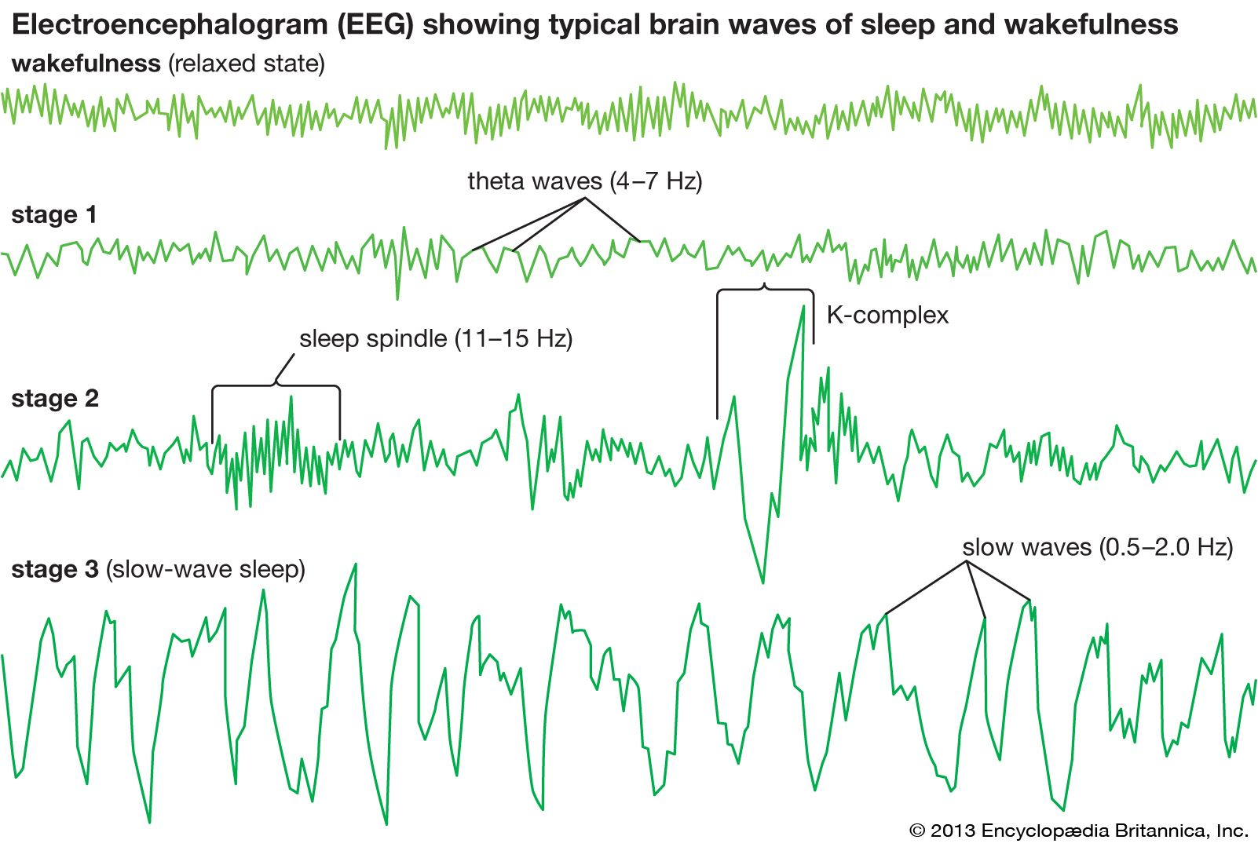
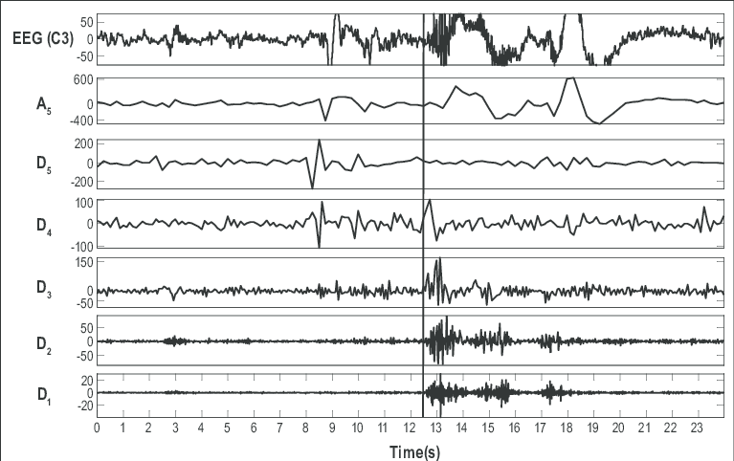
Introduction cont..
• The Figure illustrates Epileptic spike and wave discharges monitored EEG

Slide 6
LITERATURE SURVEY
S .No | Title | Authors | Description | Year
1. | Early detection of Alzheimer’s disease from EEG signals using Hjorth parameters | Mehrnoosh Sadat Safi, Seyed Mohammad Mehdi Safi | It explores the potential of utilizing EEG signals and Hjorth parameters for the early detection of Alzheimer's disease.The study investigates how specific EEG signal features, known as Hjorth parameters, can indicate the presence of Alzheimer's disease at its early stages. | 2023
2. | Smart-Data-Driven System designed for the detection of Alzheimer's disease using (EEG) signals | Teresa Araújo, João Paulo Teixeira, and Pedro Miguel Rodrigues | The system utilizes advanced signal processing techniques and machine learning algorithms to analyze EEG signals and identify patterns associated with Alzheimer's disease. | 2022
3. | Detection of Alzheimer's Disease from Electroencephalography (EEG) Signals Using Multitaper and Ensemble Learning Methods | Hanife GÖKER | The study employs multitaper and ensemble learning techniques to analyze EEG data, identifying patterns linked to Alzheimer's disease. It encompasses preprocessing EEG signals, extracting features, and employing ensemble learning for classification. The aim is to enhance early-stage Alzheimer's disease diagnosis methods. | 2021

Slide 7
S . No | Title | Authors | Description | Year
4. | Early Stage Alzheimer's Detection Using EEG | (Afsa S, Disla Abdulla, Ambadi .M. Nair, Fathima) B. Tech Student, Dept. of ECE, Adi Shankara Institute of Engineering & Technology, Kalady ,Cochin (Ms. Remya Ramesh) Assistant Professor, Department of ECE, Kalady, Cochin | This study investigates the early detection of Alzheimer's disease using EEG signals. The authors utilize EEG data and employ advanced signal processing techniques to identify patterns associated with Alzheimer's disease in its early stages. | 2018
5. | A novel methodology for automated differential diagnosis of mild cognitive impairment and Alzheimer's disease using EEG signals" | Juan P. Amezquita-Sanchez, Nadia Mammone, Francesco C. Morabito, Silvia Marino, Hojjat Adeli | The study proposes a novel methodology that utilizes EEG signals for automated diagnosis. By analyzing EEG patterns, the research aims to provide a reliable and efficient tool for clinicians to differentiate between MCI and AD, facilitating early intervention and personalized treatment strategies. | 2019
6. | Early diagnosis ofAlzheimer’s disease: the role of biomarkers including advanced EEG signal analysis | P.M. Rossini, R. Di Iorio, F. Vecchio, M. Anfossi, C. Babiloni, M. Bozzali, A.C. Bruni, S.F. Cappa, J. Escudero, F.J. Fraga, P. Giannakopoulos, B. Guntekin, G. Logroscino, C. Marra, F. Miraglia, F. Panza, F. Tecchio, A. Pascual-Leone, and B. Dubois | This study emphasize the significance of using biomarkers, particularly advanced EEG signal analysis, in improving early detection and management of AD. | 2020

Slide 8
Problem statement
Alzheimer's disease (AD) represents a significant and growing global health challenge, necessitating advancements in early detection methods for improved patient outcomes. Electroencephalography (EEG) signals offer a promising avenue for non-invasive and cost-effective detection of Alzheimer's, yet several critical challenges hinder the development of reliable diagnostic tools.Selecting suitable models, optimizing hyperparameters, and ensuring generalizability across datasets, requiring a concerted effort to improve the reliability and robustness of Alzheimer's diagnostic models.

Slide 9
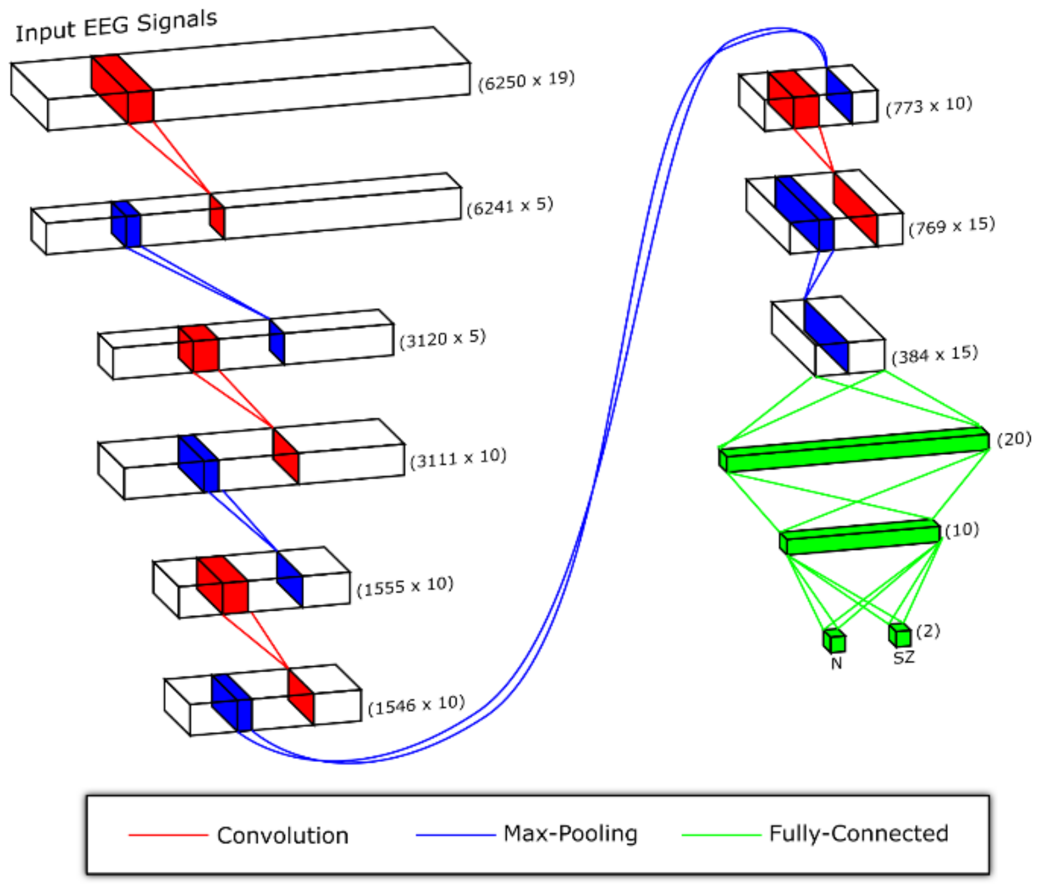
Methodology

Slide 10
Dataset
As participants remained in a relaxed state with eyes closed, fifteen minutes of EEG data was collected at a sampling rate of 250 Hz. Data was obtained via the typical International 10–20 System. The electrodes used were Fp1, Fp2, F7, F3, Fz, F4, F8, T3, C3, Cz, C4, T4, T5, P3, Pz, P4, T6, O1, O2.
The reference electrode was placed between electrodes Fz and Cz. Access to such high-quality data from reputable sources like RepOD facilitates rigorous investigation and validation of diagnostic and prognostic markers, potentially leading to improved early detection and management strategies for Alzheimer's disease and related conditions.
Quality of life is then compromised, with most SZ patients being unable to function in workplaces, 20–40% attempting suicide at least once, and between 5–10% successfully committing suicide.

Slide 11
Architecture
Input Data:
EEG Signals,
Metadata
Data Loading:
Pandas Library
Data Processing
Feature Extraction
Model Preparation:
CNN Model
Cross-Validation and Training
Output:
Evaluation Metrics,
Model Performance

Slide 12
Implementation
Implementation involves several series of steps in data handling and user interface was made to make it feasible for the usage. Major steps involved in this liver disease prediction are mainly:
Data collection
Data pre-processing
Smote the data
Training and testing
Modelling
Detecting

Slide 13
Results
As an integral component of our extensive research endeavor, we have conscientiously executed and assessed a multitude of models to ascertain the most precise and efficacious approach for predicting Alzheimer's disease. Our implemented models span a spectrum of methodologies, each endowed with distinct strengths and capabilities finely attuned to the complexities inherent in the targeted task.
Model | Accuracy
Convolutional Neural Network | 0.8444716556712932
Random Forest Classifier | 0.7175119125460665
XG BOOST | 0.7034356546401977

Slide 14
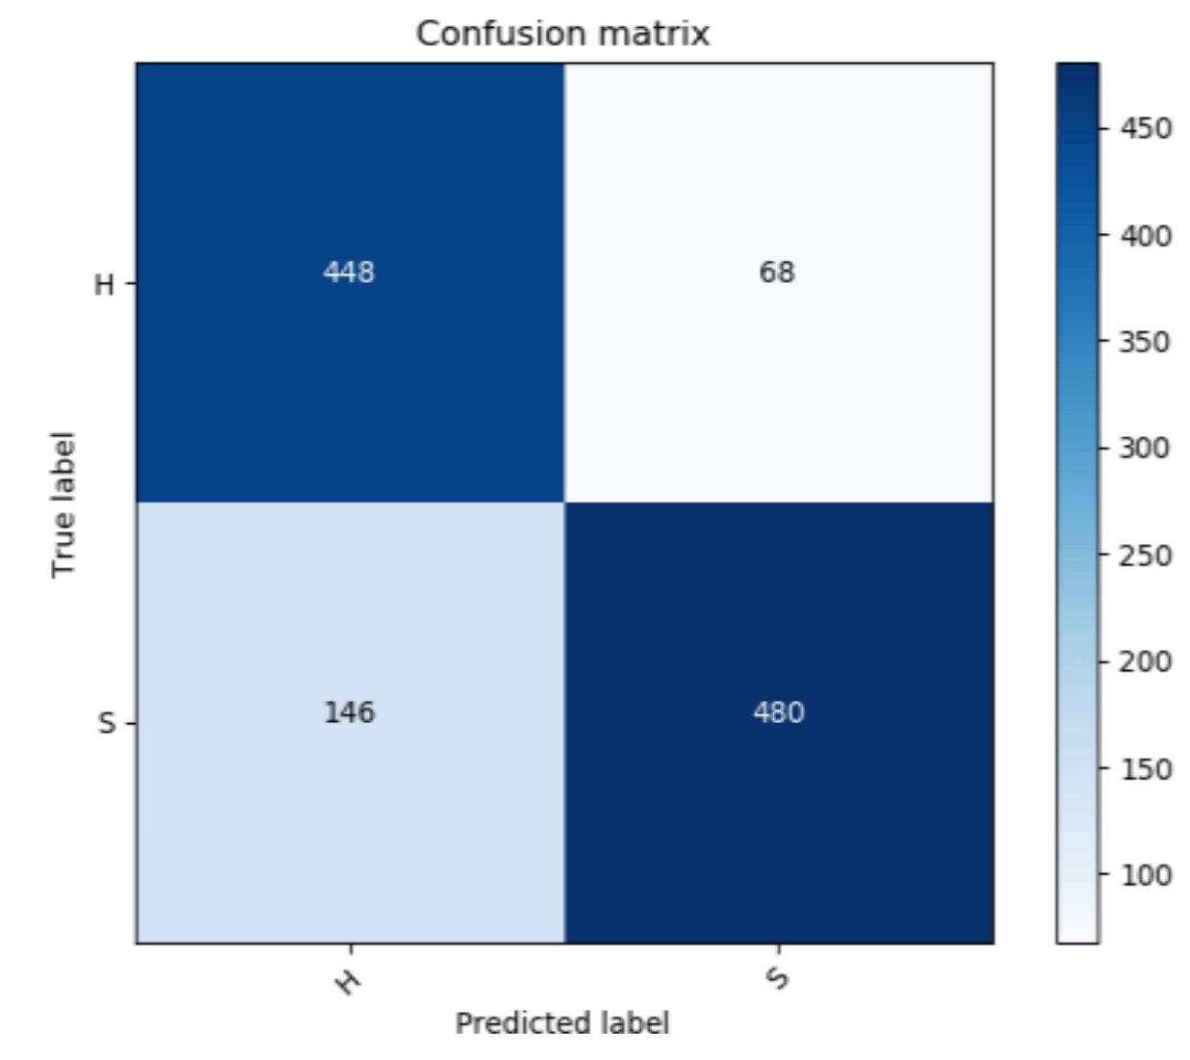
Results
The Convolutional Neural Network was obtained an Accuracy of 0.8444716556712932
When compared to other algorithms like Random Forest Classifier And XGBoost.
So we are considering CNN Has performed well on the data.

Slide 15
Conclusion
In conclusion, our project represents a significant stride forward in the pursuit of improved Alzheimer's disease prediction methodologies.
Through meticulous exploration and evaluation of diverse models, we have identified promising avenues for early detection and intervention.
By harnessing the strengths of various methodologies, we have laid the groundwork for more accurate and effective diagnostic tools.
Our findings underscore the importance of comprehensive research efforts in combating neurodegenerative diseases.

Slide 16
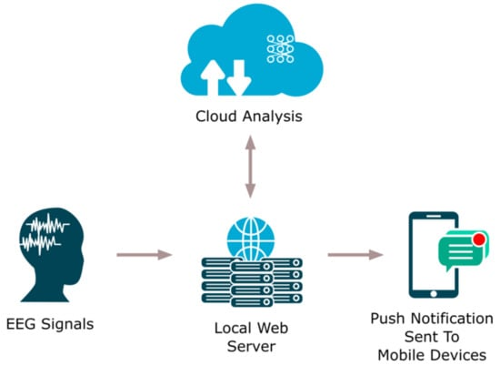
Future Scope
The diagnostic result is then ported to the clinic or hospital via the cloud.
Additionally, this technique has an edge over others, as the diagnostic result can also be sent directly to the patient via a push notification ported to mobile devices.
With the implementation of this system, the task of healthcare professionals can be made easier.

Slide 17
Reference
[1] Early Stage Alzheimer's Detection Using EEG (Afsa S, Disla Abdulla, Ambadi .M. Nair, Fathima) B. Tech Student, Dept. of ECE, Adi Shankara Institute of Engineering & Technology, Kalady ,Cochin (Ms. Remya Ramesh) Assistant Professor, Department of ECE, Kalady, Cochin
[2] A novel methodology for automated differential diagnosis of mild cognitive impairment and Alzheimer's disease using EEG signals“Juan P. Amezquita-Sanchez, Nadia Mammone, Francesco C. Morabito, Silvia Marino, Hojjat Adeli
[3] Early diagnosis ofAlzheimer’s disease: the role of biomarkers including advanced EEG signal analysis, P.M. Rossini, R. Di Iorio, F. Vecchio, M. Anfossi, C. Babiloni, M. Bozzali, A.C. Bruni, S.F. Cappa, J. Escudero, F.J. Fraga, P. Giannakopoulos, B. Guntekin, G. Logroscino, C. Marra, F. Miraglia, F. Panza, F. Tecchio, A. Pascual-Leone, and B. Dubois
[4] Early detection of Alzheimer’s disease from EEG signals using Hjorth parameters, Mehrnoosh Sadat Safi, Seyed Mohammad Mehdi Safi
[5] Smart-Data-Driven System designed for the detection of Alzheimer's disease using (EEG) signals, Teresa Araújo, João Paulo Teixeira, and Pedro Miguel Rodrigues
[6]Detection of Alzheimer's Disease from Electroencephalography (EEG) Signals Using Multitaper and Ensemble Learning Methods, Hanife GÖKER

Slide 18
Any Questions?

Slide 19
THANK YOU

